Slide 1

Ryan Allen & Z’heondre Calcano

Slide 2
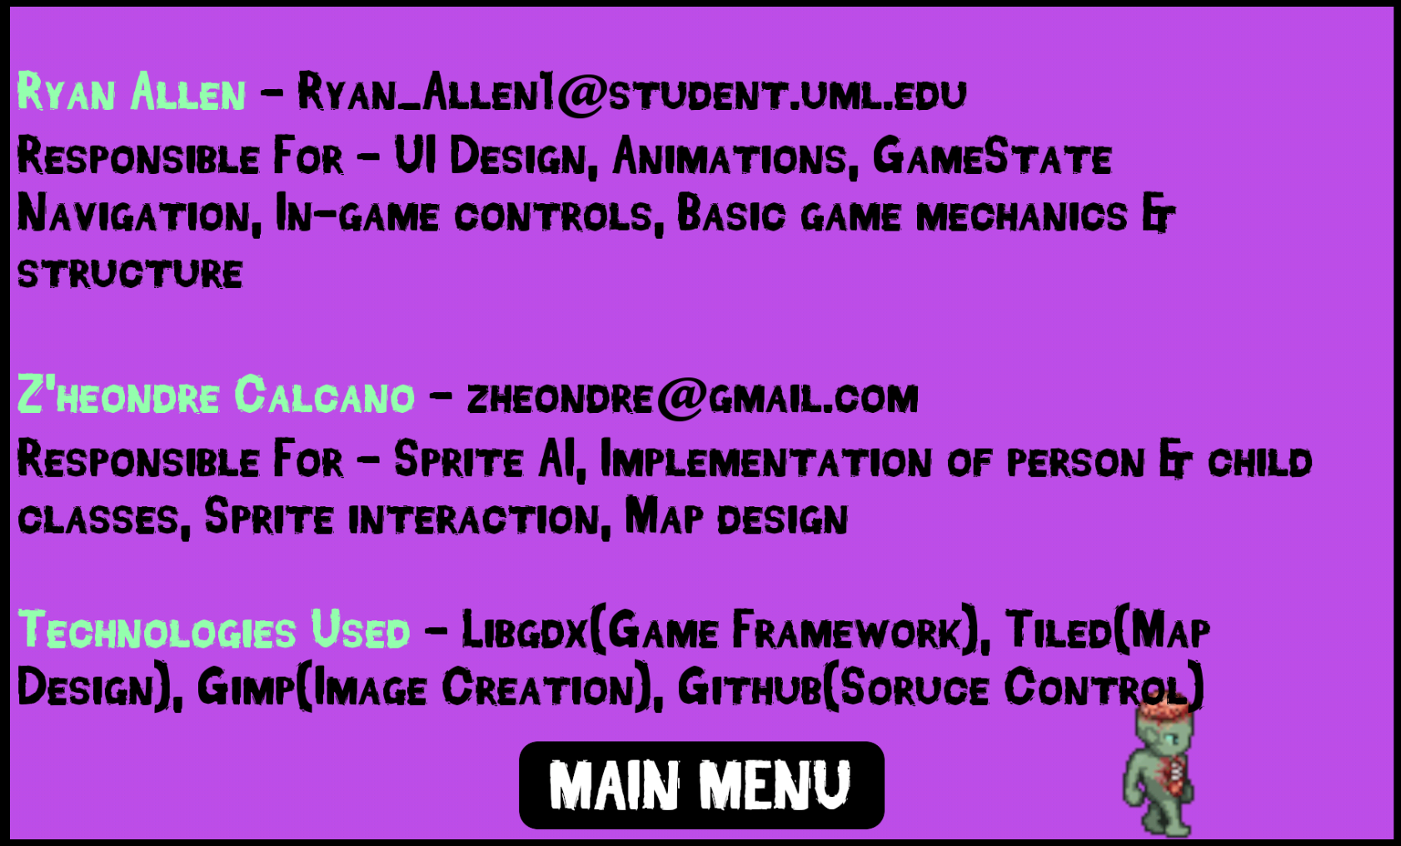
About

Slide 3
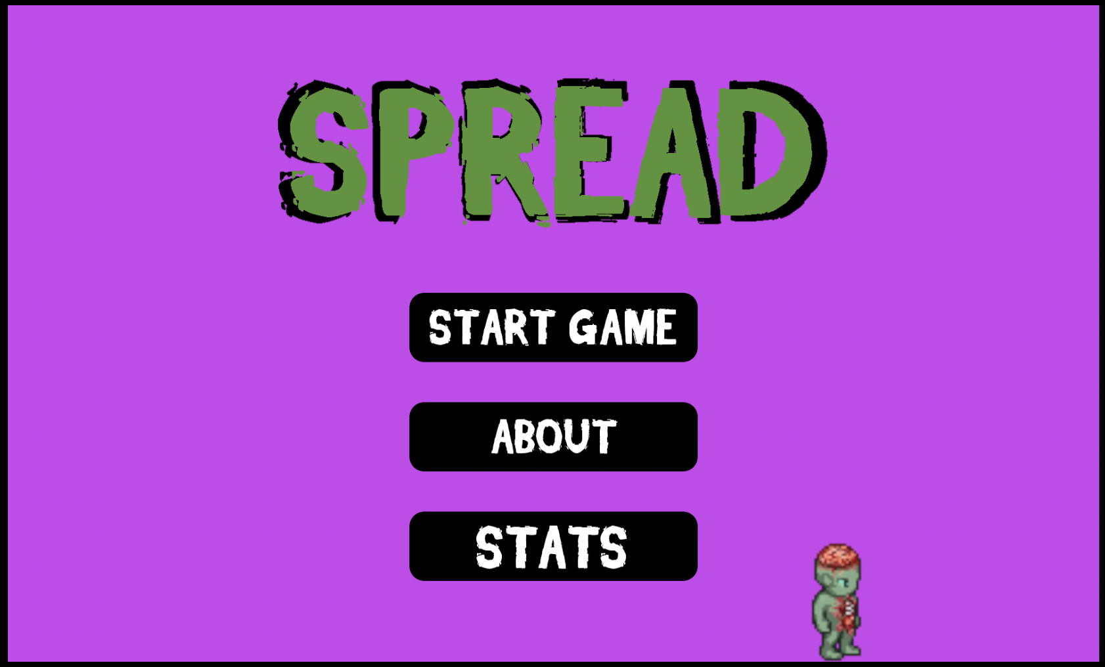

Slide 4


UI Layout

Slide 5
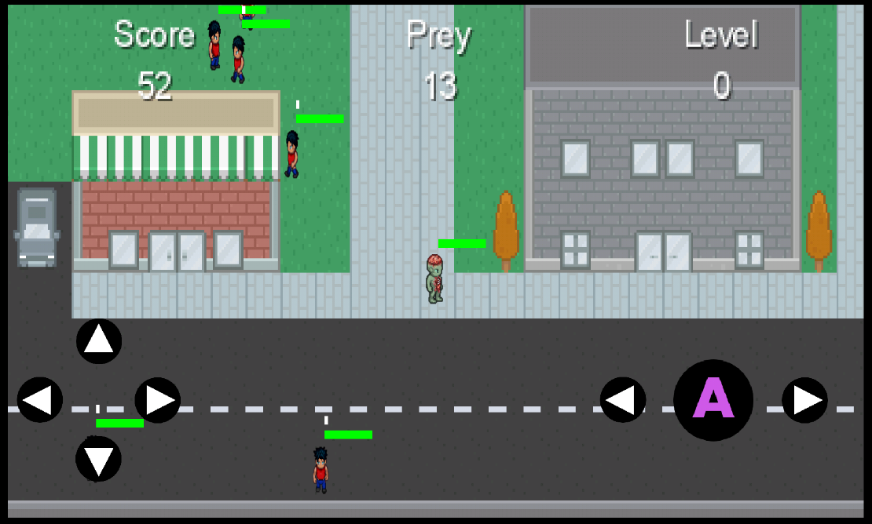
Demo

Slide 6
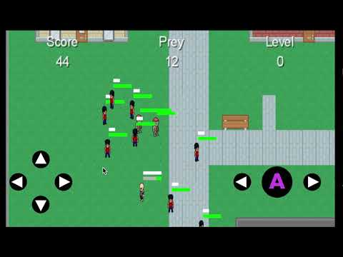

Slide 7

Animations
LibGDX animation class
Split png into array, run through array based on time
Graphics designed on Universal LPC Sprite Sheet Generator

Slide 8
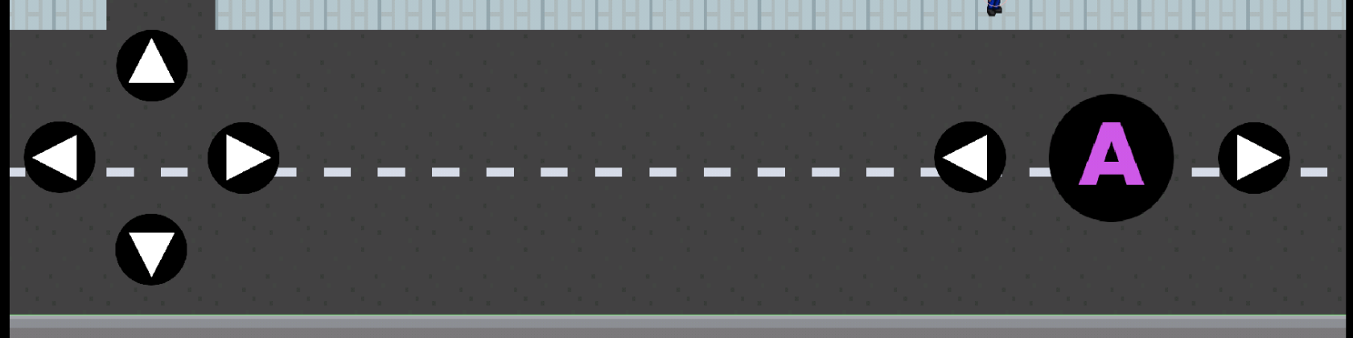
Controller
Multiple coordinate systems
Tables are the underlying data structure

Slide 9
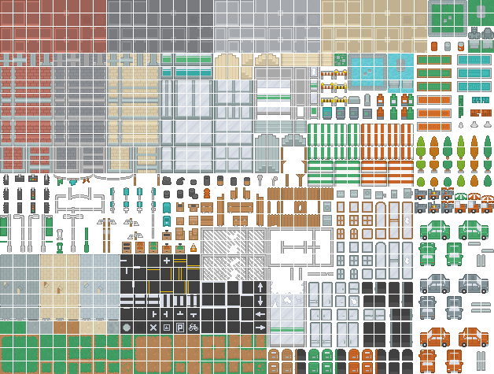
Tiled
Large sprite sheets and friendly UI make for easy map creation
Layered map files allow easier integration of boundaries for players

Slide 10
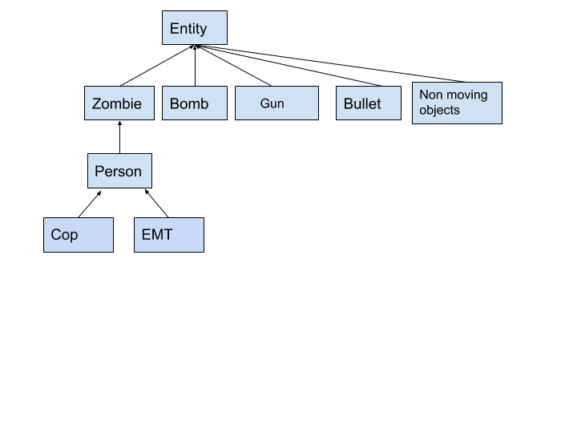
Entity Layout

Slide 11
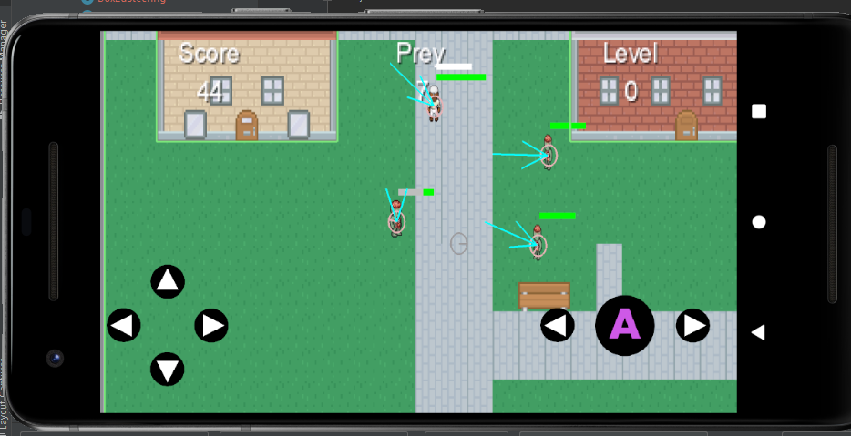
RayCasting

Slide 12
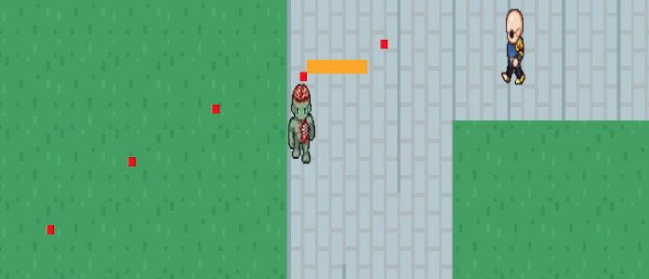

Random Walking & NPC AI
Our code generates a number between 1 to 5 to choose a direction or to keep still.
Then a random walk time is chosen. Entity steers away from other objects with raycasting.

Slide 13
Stats & Saving
Used external file for stat retrieval
Saving is done on intervals to reduce writing and improve performance

Slide 14
Libraries used
Libgdx
Contains steering Ai libraries
Ai Messaging
Box2d
Physics library
Tiled
Map creation & layering

Slide 15
Ryan - What I learned
What I learned:
Version control with Github
How to setup Android Studio with libraries such as LibGDX
Animation integration with sprite sheets
Resource management when managing game states
External file retrieval techniques for storing local data
Many details regarding game logic I hadn’t previously considered

Slide 16
Z - What I worked on
Zombie
Only chase after the closest non zombie, player can switch between zombies.
Civilian
Any one that is not a zombie can communicate with each other through the libgdx AI message system. Can ask for help, warn others, attack if they have weapon or evade.
Emt
Help civilians in need by healing an infection when, they can revive someone that has not been cleaned off the map yet.
Cop
Will shoot at zombie if it is safe to do so, will follow a close by Emt, can call for help or more back up.

Slide 17
Z. Problems I ran into
Getting random walking steering behavior to work properly. The entity would move really awkward and it didn't seem natural. Tweaking the settings took too much time so I wrote my own.
Duplicating code, sometimes it was just necessary.
Rewriting code and restarting the app for testing- it would have been nice to be able to have game command line interface where we set things on the fly while debugging & testing.
Using the AABBQuery as a line of sight, if the points are placed correctly it wont fire the interrupt.
Merge Conflicts

Slide 18
Z .What I learned
Definitely learned more about the libgdx library and box2d.
Collision, Ray Casting, and Area Querying interrupts.
These save time and are more efficient than having each entity looping through a list of entities.
Test features of a library before you start writing code, reinventing the wheel wastes time.
Don’t dispose an object that is in the array you are currently iterating through.

Slide 19
Questions?

